Slide 1
IBM University Engagement Project Submission
“Exploring the Power of Agentic AI with IBM Granite and LangFlow”

Slide 2
Project Tile – [Agri Doctor Agent]
Domain of Project – [Agriculture]
Faculty Name | Recent Passport Photo | Email ID | Mobile number [WhatsApp]
Dr RAHUL GUPTA |  | errahulgupta73@gmail.com | 9286402578

Slide 3
Problem Statement -
Problem Statement : Agri Doctor Agent
The Challenge
Agriculture is the backbone of food security, yet farmers often struggle with crop diseases, soil health management, pest infestations, and unpredictable weather conditions. Reliable agricultural knowledge is scattered across sources and often inaccessible in real time. Without timely, personalized guidance, farmers may face reduced yields, crop losses, and inefficient resource use. Many lack access to expert agronomists, making it difficult to make informed decisions on crop care and farm management.
The Objective
Build an AI-powered Agri Doctor Agent that delivers personalized, real-time agricultural insights and guidance for farmers, agronomists, and agricultural stakeholders. The solution should:
Personalized Crop Advisory – Recommend crop selection, fertilizers, irrigation, and treatment plans based on soil type, weather, region, and crop stage.
Agricultural Data RAG Retrieval – Fetch and summarize reliable data on crop diseases, pest control, soil nutrients, and best farming practices.
Farm Monitoring & Feedback – Allow users to log crop conditions via text, images, or voice and receive instant diagnosis and treatment suggestions.
Preventive Farming Focus – Provide proactive recommendations for disease prevention, pest management, and climate-resilient farming practices.
Multi-Agent System –
Crop Knowledge Agent (fetches agricultural and crop data)
Advisory Agent (provides personalized farming recommendations)
Plant Health Agent (diagnoses diseases and suggests treatments)
Farm Log & Feedback Agent (tracks farm activities and analyzes outcomes)
Visualization Dashboard – Display crop health trends, soil condition insights, weather impact analysis, and farm productivity over time.

Slide 4
Technology Used
Tech Stack (Mandatory)
LangFlow + IBM watsonx.ai + Granite Models

Slide 5
Proposed Solution -
The proposed solution is a multi-agent AI-powered Agri Doctor Agent built using LangFlow, IBM watsonx.ai, and Granite Models to provide personalized, real-time agricultural guidance. The system addresses challenges in crop management, pest diagnosis, soil health monitoring, and preventive farm advisory through an intelligent, modular architecture.
At its core, the solution uses a Retrieval-Augmented Generation (RAG) pipeline to fetch accurate agricultural knowledge from trusted sources such as ICAR, FAO, Krishi Vigyan Kendras (KVKs), agricultural research databases, and weather APIs. This data is embedded and stored in a vector database, enabling the system to retrieve and summarize crop-related insights such as disease symptoms, treatment options, fertilizer recommendations, and climate advisories using Granite models.
The system consists of four key agents:
1. Crop Knowledge Agent retrieves and summarizes agricultural information using RAG, including crop cultivation practices, pest and disease management, irrigation methods, and fertilizer usage.
2. Smart Advisory Agent generates personalized farming recommendations based on user inputs such as crop type, soil condition, season, location, and farming goals, helping farmers optimize productivity and reduce risks.
3.Plant Health Diagnostic Agent provides preventive and corrective solutions by diagnosing crop diseases and pest attacks through text, voice, or image inputs, offering treatment suggestions and sustainable farming practices.
4. Farm Log & Feedback Agent allows farmers to record activities such as sowing, irrigation, fertilizer application, and crop observations, while delivering real-time analysis, alerts, and actionable feedback for improved farm management.
The solution includes a user-friendly dashboard that visualizes crop health status, weather forecasts, soil nutrient levels, pest alerts, and farm progress, enabling data-driven decision-making.
LangFlow is used to orchestrate agent workflows, while watsonx.ai ensures scalable model deployment, embeddings, and AI governance. Granite models power reasoning, diagnosis, summarization, and personalized recommendations.
Overall, this solution delivers an end-to-end intelligent Agri Doctor Assistant that promotes sustainable agriculture through personalized advisories, real-time crop monitoring, early disease detection, and preventive farming support.

Slide 6
Langflow component Used -
1) Chat Input – Interface where users enter their queries, preferences, or meal details (text/voice/image).
2) IBM watsonx AI Agent - Processes user input using Granite models to generate personalized nutrition insights and recommendations.
3) Name of IBM Granite model - Granite-4.0-8B-Instruct → Fast, efficient for real-time diet recommendations
4) Chat output -Displays AI-generated responses such as diet plans, nutritional analysis, and health suggestions.
5) File component - Stores and retrieves user data, meal logs, and nutritional datasets for analysis and tracking.

Slide 7
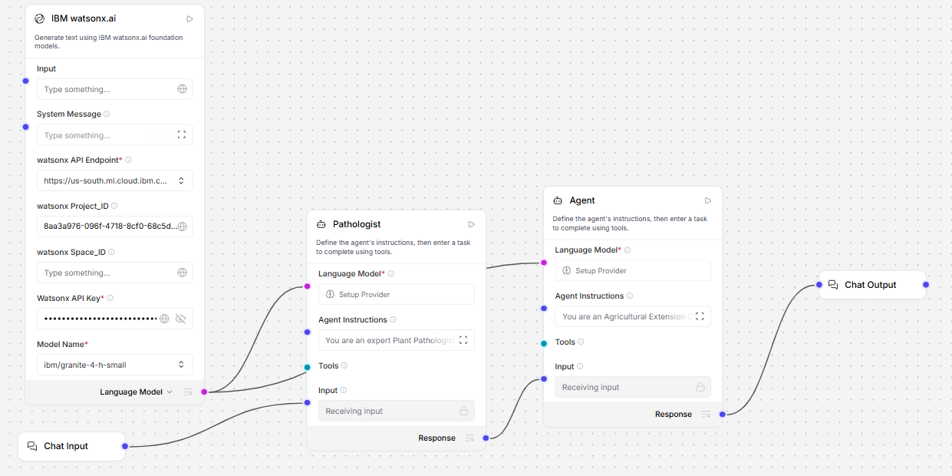
Langflow workflow -

Slide 8

Architecture blueprint

Slide 9

Role of Agentic AI in the solution
Role of Agentic AI in Agri Doctor Agent
Agentic AI enables the Agri Doctor Agent to function as an intelligent, autonomous system rather than a simple advisory chatbot. Using IBM watsonx.ai and IBM Granite models, it coordinates multiple specialized agents to deliver personalized agricultural guidance.
Each agent performs a specific role such as retrieving crop and soil information, generating farming recommendations, diagnosing plant diseases, and monitoring farm activities while working collaboratively. This multi-agent approach ensures efficient task execution and accurate solutions.
Agentic AI also brings context awareness, understanding factors such as crop type, soil condition, weather patterns, and farmer needs to generate tailored recommendations. It supports real-time adaptation, continuously updating suggestions based on changing farm conditions, pest outbreaks, or climate data.
Additionally, agents communicate with each other, enabling better decision-making and improved outcomes. Overall, Agentic AI makes the system proactive, personalized, and goal-driven, acting like a smart digital agricultural expert that helps farmers improve productivity and promote sustainable farming.

Slide 10
Technology Used
Langflow platform -For designing and orchestrating multi-agent workflows visually
IBM Grainte model - for eg – ibm-granite-4h-small – For natural language understanding, reasoning, and personalization
IBM Cloud – It provides the infrastructure to build, deploy, and scale the Nutrition Agent efficiently. IBM Cloud enables a reliable, secure, and scalable environment for deploying the Nutrition Agent.
RAG– RAG to fetch real data first, then generate intelligent answers, making the Nutrition Agent more trustworthy and effective.
IBM Watsonx.ai - For model deployment, embeddings, and AI governance

Slide 11
Novelty and Uniqueness
The proposed Agri Doctor Agent stands out by combining Agentic AI, RAG, and personalized farm advisory into a single intelligent system.
Multi-Agent Intelligence – Instead of a single chatbot, multiple specialized agents collaborate to provide accurate and context-aware agricultural guidance.
RAG-Based Accuracy – Integrates real-time agricultural knowledge retrieval with AI generation, reducing misinformation and ensuring trustworthy recommendations.
Personalized Farm Advisory – Tailors recommendations based on crop type, soil conditions, weather patterns, and farmer needs.
Real-Time Adaptive Support – Continuously updates suggestions based on changing farm conditions, pest outbreaks, and climate data.
Multi-Modal Input – Supports text, voice, and image-based crop disease diagnosis for improved accessibility and usability.
Preventive Farming Focus – Goes beyond problem-solving to provide early warnings, disease prevention, and sustainable farming practices.
Scalable & Enterprise-Ready – Built on IBM watsonx.ai with IBM Granite models, ensuring reliability, scalability, and AI governance.
This makes the solution a smart, adaptive, and proactive digital Agri Doctor, not just a static farming advisory tool.

Slide 12
Git Hub Link
https://github.com/randeeppoonia1983-bit/DrRahul-AgriDoctor.git
·
·
·

Slide 13
Future Scope
Integration with IoT Sensors and Smart Farming Devices
The system can be integrated with soil sensors, weather stations, drones, and smart irrigation systems to collect real-time data such as soil moisture, temperature, humidity, and crop health. This will enable the Agri Doctor Agent to provide more accurate and dynamic recommendations for irrigation, fertilization, and pest management based on actual field conditions.
2. AI-Powered Voice Assistant & Multilingual Support
Enhancing the system with a voice-enabled assistant and support for multiple languages will improve accessibility for farmers. Users can interact naturally in their preferred language, making the solution more inclusive and suitable for diverse farming communities, especially in rural areas with varied linguistic backgrounds.
·
·
·

Slide 14


